Slide 1
P56: Benchmark Commercial AI product for Medical Imaging Services Provider
Kiran Papalkar 490411205 kpap8603 Bronte Lee 490420056 blee6992
Benjamin Men 500401903 jmen0495
Zheyuan Zhang 500023392 zzha3548 Cailin Feldman 480439062 cfel2589
Andersen Liu 480022439 bliu3122(Other group name: SOFT3888_TU12_01(RE), project name: P08 - WeBike)
Zichen Li 500174041 zili4471 (Other group name: SOFT3888_W16_02(REMOTE), project name: P25 - Travel plan and diary application)
Project Name: Benchmarking Commercial AI-ISYS3888
Project Period: 2022/8 - 2022/12
Sponsor(s) Client: Professor Simon Poon
Organisation: USYD
Project Supervisor: Yaoqi Huang
Class Time: Tuesdays 3:00pm-5:00pm

Slide 2






Overview
The project involved an:
Evaluation of the commercial AI product qXR by conducting a meta-analysis and then providing our recommendations to our clients which will help their decision whether or not to invest in qXR.
Identification of factors that affect user acceptance when AIs are introduced to medical imaging practices from a thematic analysis to help help limit the impact on the workflow when the new technology is introduced
By using PRISMA (for our source finding) and ÉCLAIR (for the structure of our evaluation) guidelines
Risks
Insufficient evidence
Time
Stakeholders
Simon Poon and Neysa Petrina (Information System researchers)
ABC Company (Medical health care professionals and their patients )
We also used resources provided by our original client (Simon Poon)

Slide 3
Quality of System Specification
Functional Requirements:
Informed by ECLAIR Guidelines
Benchmark qXR against other AI products
Identify Efficiency of AI products
Non-Functional Requirements
Report covers all requirements
Meets client’s time demands
Report uses reliable research
Technical Constraints
Consistency
Bias
Data Availability
# | User Story | Acceptance Criteria | Requirement | Status
1 | As a medical imaging provider, I want a comprehensive report so that I can justify my use of qXR. | Report covers all topics that client has requested | Non- Functional | Done
2 | As a radiologist, I want to have an accurate AI product to detect TB so that I can give the correct diagnosis. | Most accurate AI product identified in comparison to others through analysis of AUC | Functional | Incomplete
3 | As a radiologist, I want to have an efficient AI product to detect TB so that I can identify issues and assist my patients in recovering as soon as possible. | Efficiency of qXR is elaborated on. | Functional | Done

Slide 4
Remaining User Stories
As a medical imaging provider, I want to have a knowledge of what qXR can bring us and what kind of patients it aims for. | Show that qXR’s benefits and its targeted user
As a medical imaging provider, I want to know if there are any risks that may occur in using qXR so that I can be aware of and mitigate them | Any risks present in the system are identified
As a medical imaging provider, I want the performance and validation of qXR to be wholly covered in the report so that I can evaluate its benefit to me | Performance and validation is completed
As a radiologist I want the specifications of the algorithm to be clear so that I can better understand how it functions | Clearly state design specifications of qXR
As a radiologist, I want to know how qXR’s algorithm be trained so that I can better understand how it works | Clearly explain the algorithm trained
As a medical imaging provider, I require knowledge of how qXR’s performance has been evaluated so that I can ensure it is the best option | An evaluation for qXR’s performance
As a medical imaging provider, I want to ensure that the selected product is unbiased so that I can accept it as a valid product | Potential biases of qXR are assessed
As a radiologist, I want to ensure that qXR is the most appropriate AI tool for my needs so that I can treat my patients accordingly. | qXR successfully benchmarked against competitive AI tools that are certified, usability of qXR is identified, qXR is successfully argued to be best choice for client
As a medical imaging provider, I want a reliable report so that my decision is well informed. | Report is well researched and thorough
As a medical imaging provider, I want to have the report by my required date so that I can make decisions in a timely manner | Report is submitted by the due date
As a radiologist, I want a product that will not interrupt my workflow so that I can maintain my focus on treating patients. | Identify the impact qXR has on the workflow and whether it helps or hinders the clinical workflow of radiologists when diagnosing TB
As a radiologist, I want to know what problem qXR is solving in my worklife so that I can better understand the product | Adequately explain the problem and define users
As a radiologist I want to know if the result from qXR is interpretable or not. | Identify the clarity and user feedback on qXR’s results and is there any difficulty for interpreting the result generated from qXR.
As a medical imaging provider I want to be aware of the legal status of qXR in Australia Identify the laws that apply to medical devices in Australia, determine whether qXR can be legally used, and if not, the pathway for qXR to become legal in Australia | As a medical imaging provider I want to be aware of the legal status of qXR in Australia Identify the laws that apply to medical devices in Australia, determine whether qXR can be legally used, and if not, the pathway for qXR to become legal in Australia
As a radiologist I want to know the licensing model for qXR. | Identify the licensing model for qXR.
As a medical imaging team, I want to know what the training process involved to use qXR | training process involved to use qXR
As a radiologist I want to know how much maintenance is required once qXR has been implemented into the imaging system because I need to know how much resources it will require | Identify maintenance costs and frequency
As a radiologist I want to know how the potential malfunctions and errors from qXR can be resolved because I need to know that any issue that arises will have instructions to solve the error | Potential malfunctions and errors identified
As a medical imaging provider, I need to know whether the algorithm is adapted to new data so that I can long term use this algorithm | Find whether the algorithm is fixed or adapting to new data
As a radiologist, I want to ensure that qXR can be easily integrated into my workflow so that I am not unnecessarily hindered by using it | State the integration process
As an owner of a medical imaging practice, i want to know what are the IT requirements to implement qXR | Identify IT requirements
As a medical imaging provider, i want to know what the data output by qXR be used for | Identify what data is being used
As a medical imaging provider, I want to know if the output of qXR will be given to other people instead of radiologists. | Identify who can get access to the data

Slide 5
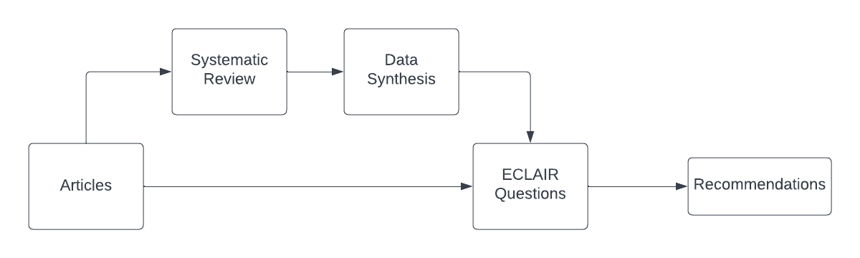
System Architecture and Design
Report Structure
Executive Summary
Introduction
Relevance
Performance and Validation
Usability and Integration
Regulatory and Legal Aspects
Financial and Support Services Considerations
Conclusion
System Components

Slide 6
Quality of the whole work
Quality Assurance Testing
Article Quality
Systematic Review Quality
Meta-analysis Quality
Thematic Analysis Quality
Evaluation Quality
Report Quality
Presentation Quality
Acceptance Testing
Evaluate whether the user stories were correctly implemented

Slide 7
Quality Testing
When Tested | Test Results | Improvements Made
Week Seven: after first attempt of systematic review was complete | UX Six articles were identified through Google Search. Some search results were not journal articles. Successful Technical Successful Some results were not journal articles. Successful | Google Search no longer used. Google scholar was removed as an identification method. Use filters to limit search results to journal articles where possible.
Week Ten: after second attempt of systematic review was complete | UX Successful One result was not a journal article. Successful Technical Two articles were not identified through valid identification methods. Successful Successful | Non-journal article removed. For the two articles that were invalidly identified, one was re-identified through Qure.ai’s website and the other was found to be a pre-print duplicate of an already included published article.
Week Ten: after making the improvements from the previous test | UX Successful Technical Successful
Article Quality Criteria
Use databases and journals to search for articles. Another acceptable source is the website of the product and government resources.
The systematic review articles must be limited to journal articles.
A company who makes a product evaluated in a study undertaken must not have funded the study undertaken in the article.

Slide 8
Acceptance Testing
# | User Story | Acceptance Tests | Status
1 | As a medical imaging provider, I want a comprehensive report so that I can justify my use of qXR. | Does the report cover all ECLAIR evaluation questions? Is there evidence of research and analysis? Do the recommendations have a clear justification and explain whether qXR is worth investing in? | Report contains an answer for every ECLAIR question. All sections contain references and analysis. The recommendations are backed by the evaluation using ECLAIR and reach a final recommendation of what to do next. Successful
# | User Story | Acceptance Tests | Status
2 | As a radiologist, I want to have an accurate AI product to detect TB so that I can give the correct diagnosis. | Have multiple diagnostic test accuracy studies been identified? Was meta-analysis performed to benchmark the AI products? Was the most accurate AI product identified? | Yes, section 3.3.3 Partially, sensitivity and specificity and SROC was completed, however, ROC and AUC were not. Sections 3.3.4, 3.3.5 and 3.3.6 Yes, however, not based on the complete range of expected analysis Incomplete

Slide 9
Quality of the Application of Discipline Knowledge and Tools
Discipline:
ISYS3401 background knowledge
PRISMA
Thematic analysis
ECLAIR
ROC and AUROC
Heterogeneity
Tools:
Communication:
Slack and Zoom
File management:
Google Drive and BitBucket
Data analysis and visualization:
Tableau
Notes:
In this project, the knowledge we need are ISYS3401 background knowledge, PRISMA (a protocol for Systematic Reviews and Meta-Analyses), Thematic analysis (a common form of analysis within qualitative research), ECLAIR (a commercial static code analysis tool) , ROC and AUROC (a performance measurement for the classification problems at various threshold settings), and Heterogeneity (it is very common in meta-analysis which means there is variability in your data)’
Talking about tools, they can be divided into 3 aspects.
Since we are a hybrid team, communication tools are very important, we used slack for the text contact, and slack also provided grouping function which can help us increase our productivity
We also use zoom for different types of meeting, such as tutor meeting and client meeting
For file management, we used google drive and bitbucket. Bitbucket is the official one, so we didnt upload any draft. For those early stage work, we stored them in google drive
For Data analysis and visualization, some of us try to use R studio, but tableau also can satisfy project requirements, and tableau better ease to use, that why we choose tableau.

Slide 10
Quality of response to key changes
Scope Change
First Stage
Systematic review and meta-analysis on all certified AI products that diagnose tuberculosis
Second Stage
Divide into 2 sub-teams: technical team and user experience team.
Technical team remains the same task
UX team: systematic review and meta-analysis to measure factors affecting user acceptance of AI in medical imaging

Slide 11
Quality of response to key changes
Third Stage
Benchmark qXR against all other competing AI products for detecting TB
ECLAIR Guidelines
Final Stage
The company has hired the group to prepare a professional report evaluating the product
Provide a recommendation of whether choosing qXR or not

Slide 12
Demonstration

Slide 13
Evaluation of qXR and Recommendations
Client: representative of ABC, a health services company
Evaluation of qXR using the ECLAIR guidelines
Recommend whether to invest in qXR

Slide 14
ECLAIR Recommendations
Relevance
Invest in qXR to take advantage of its benefits
Maintain a risk register to monitor and manage potential risks
Performance and Validation
Invest in qXR because it is a thoroughly trained and adaptable algorithm that accounts for biases
Usability and Integration
Use an AI marketplace vendor to simplify integration of the AI into the workflow.
Provide staff with support and resources to equip them with the knowledge to understand, trust, and use qXR
Regulatory and Legal Aspects
Seek a sponsor for qXR for it to become legally approved in Australia
Financial and Support Services Considerations
Determine the number of annual studies, concurrent users, and sites to receive indicative pricing

Slide 15
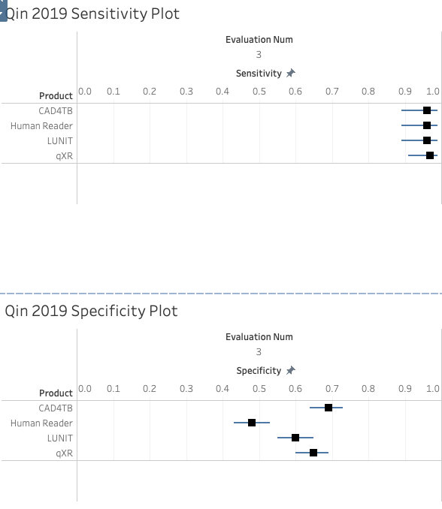
Forest Plots
Heterogeneity
Paired forest plots are compared and we decide if they are homogenous
Visualisation
Also useful in visualising the confidence intervals that are not present in other visual evaluation

Slide 16
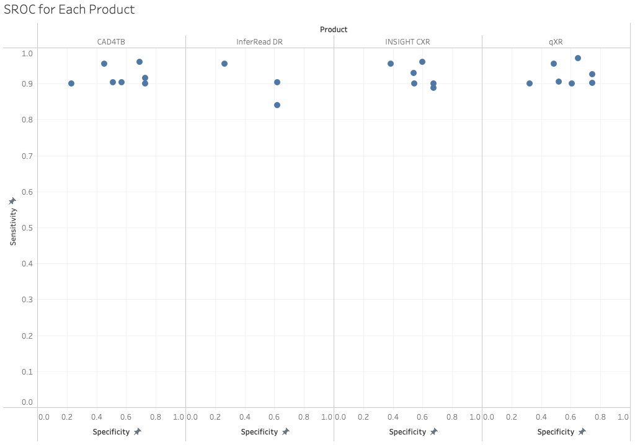
SROC Graph
Visualisation
Allow us to visually see DTA of all analysed products
qXR has the best overall performance
SROC Curve
Unable to plot because of the extent of data needed

Slide 17
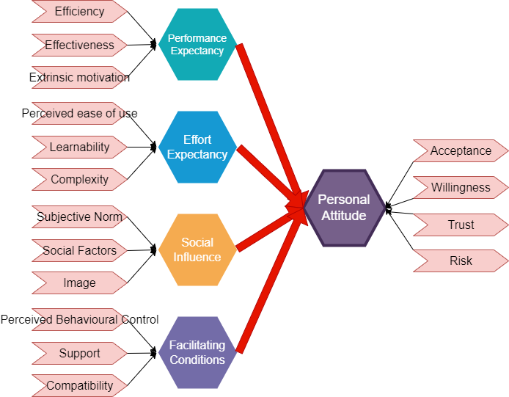
User Experience Focus Areas
Findings:
High effectiveness.
Require changes at work.
Effort expectancy not related to Intention of use.
Social influence impacts trust.
Trust is correlated to attitude.
Conclusion:
Concern: Job replacement + Legal aspects
More knowledge is needed
Willingness are high
Trend is being recognized
Social influence is important
More tech experience makes AI more acceptable.

Slide 18
Final Recommendation
Choose qXR
Emphasis on the knowledge of the users
Do a pilot of the qXR
Identify radiologist opinion and identify the efficiency and effectiveness of the practical qXR performance.

Slide 19
Quality of Group Processes
Structure:
Tech team
- Kiran (manager)
- Anderson
- Edward
- Zheyuan
UX team
- Bronte (manager)
- Cailin
- Benjamin
Team manager: Cailin
XP roles:
Customer Liaison: Cailin
Programmer: Bronte + Kiran
Other roles: take turns weekly
Issues and solutions:
Ambiguous standard Write our own protocol.
Progress tracking SCRUM method.
Team communication:
Slack
Two group meetings (zoom)
SCRUM questions method:
- 1. What work have you done since we last met?
2. What work are you planning on doing?
3. Roadblocks faced?
Client communication:
Email
Client meeting once weekly (zoom)
Task allocation:
Proactive + voluntarily

